Slide 1
Harmful substances for our health
Kateřina Schmidtová
DOP3 KS

Slide 2
Synopsis
Where are harmfull substances
How to reduce impact on our bodies

Slide 3
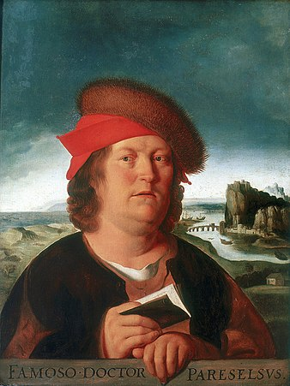
The dose makes poison
“All things are poison and nothing is without poison; only the dose makes a thing not a poison.” Paracelsus 16th century

Slide 4
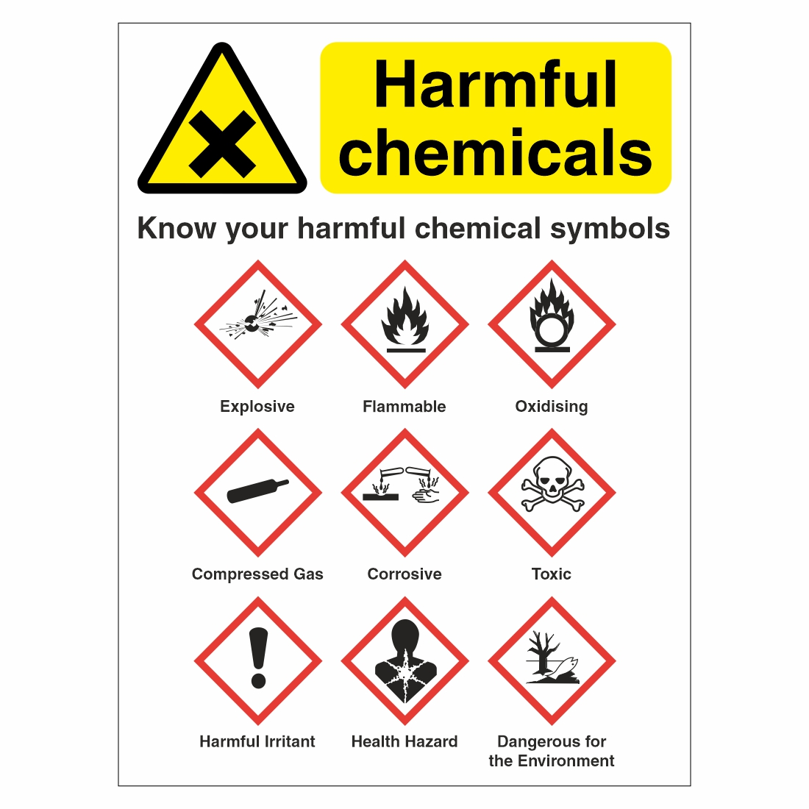
Factors of toxicity
Chemical properties
Solubility
Evaporation
Environment
Individual physical condition

Slide 5
Input
Airways
Oral
Skin

Slide 6
Output
Metabolism
Urine, digestive system, sweat,
breath
Storage in tissues

Slide 7
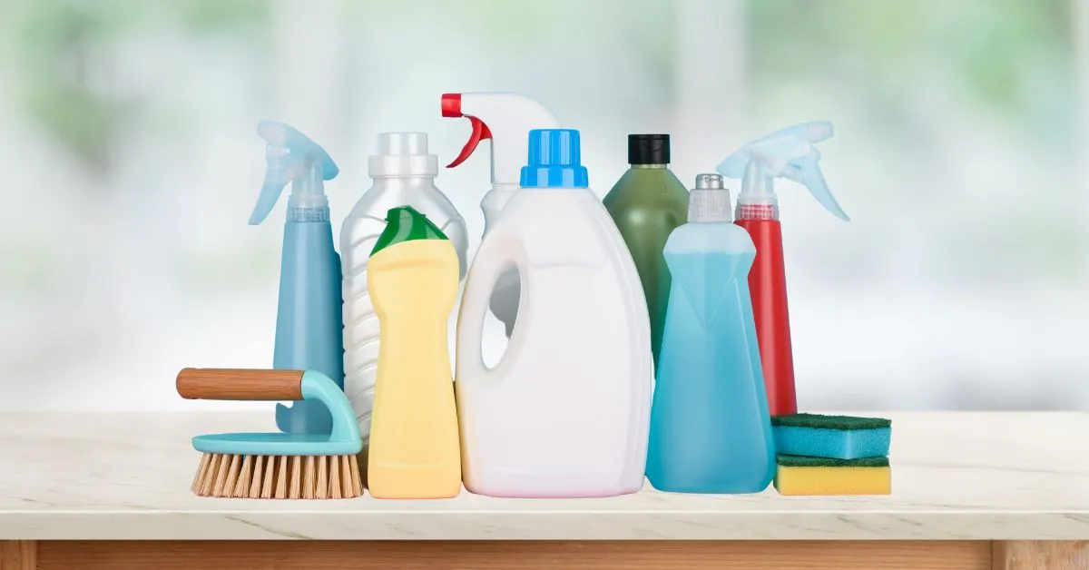
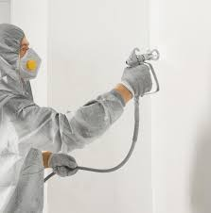
Exposed everywere
Environment
Workplace
Home
Food
Personal preferences

Slide 8
Environment
Air
NOx, SOx, PM 2,5, combustion, heavy traffic
indoor from materials, furniture, moulds, asbestos
Water
Tap water
Soil
Radon, heavy metals
Ostrava-Přívoz

Slide 9
Solution as a individual

Slide 10
Solution

Slide 11
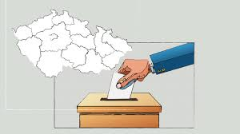
As a member of society
Public election

Slide 12
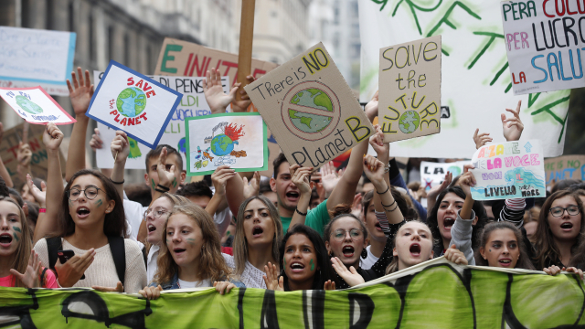
As a member of society
Public election
Demonstration

Slide 13
Workplace / home
Chemicals
Particles
Food
Optical profesion
microplastics, debrits, organic solvent, vapours

Slide 14
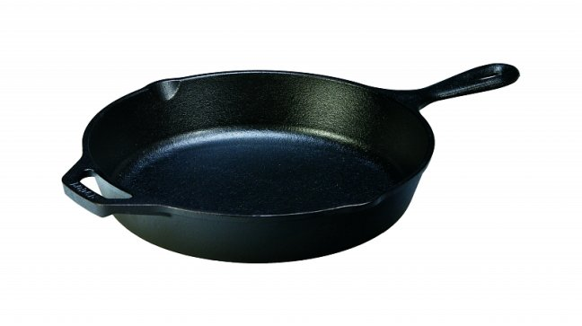
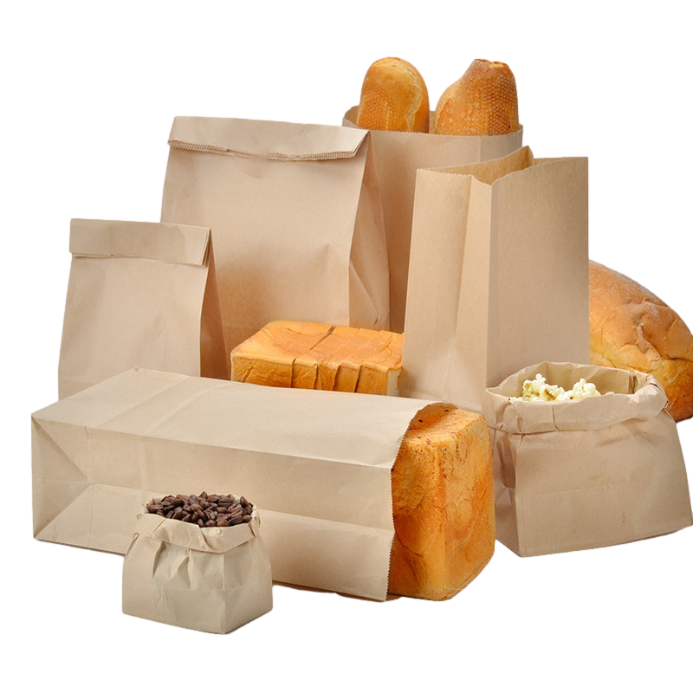
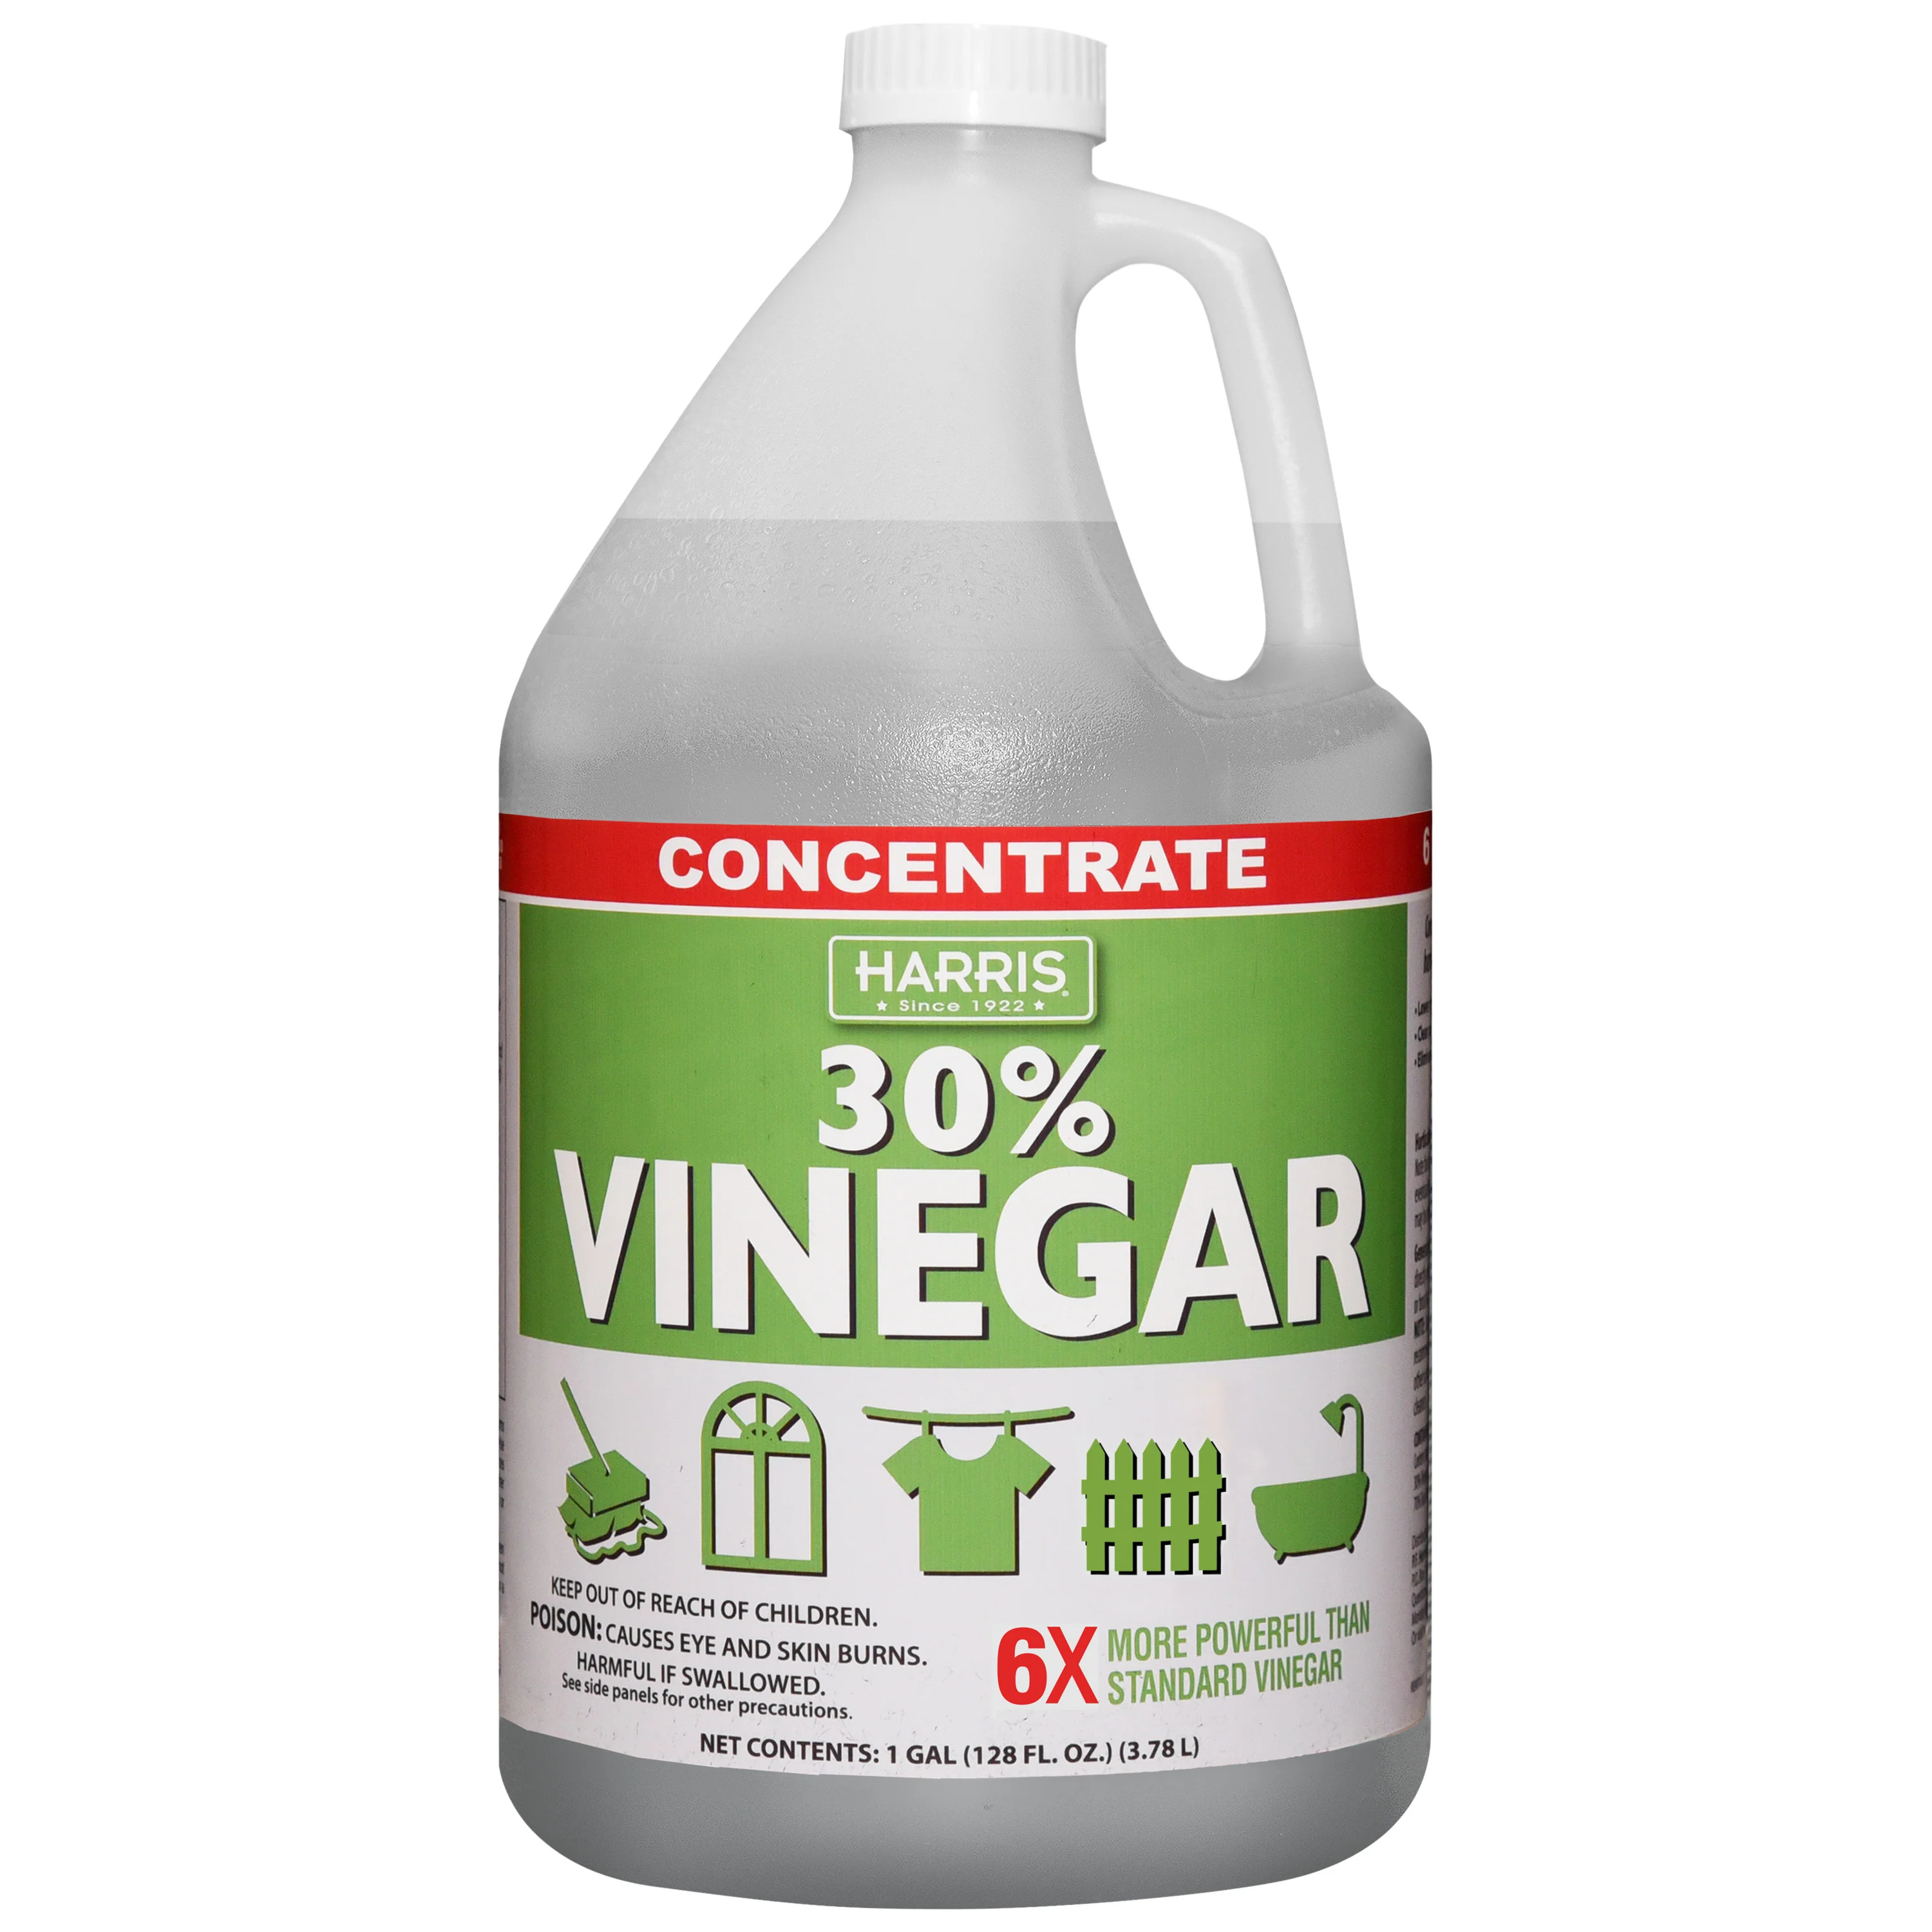
Make a choice, educate yourself
Baking soda, vinegar
Glass containers
Cast iron, carbon iron pan
Paper, cotton, linen bags
Avoid plastic materials, teflon
BPA-Bisphenol A
Monomer for polycarbonate

Slide 15
Protection
Gloves
Fume hood
Opened windows
Cleaning workplace regularly
Air purifier
Respirators
Masks with fume filters
Shields, protective glasses
Protection of environment

Slide 16
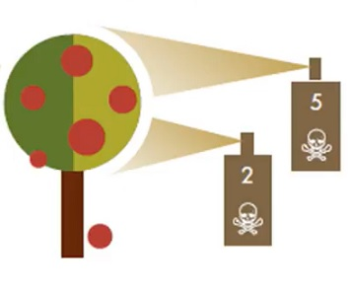
Food
Additives
Antibiotics
Pesticides
Microbe toxins
Food containers, coatings

Slide 17
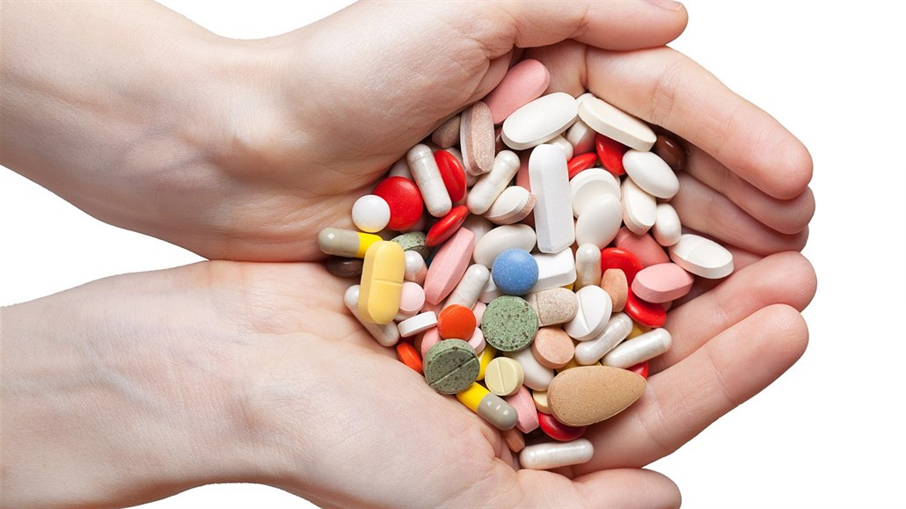
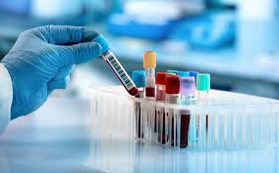
Medication
Regular checkups

Slide 18
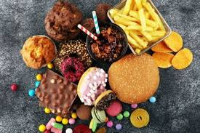
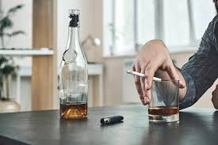
Personal preferences
Unhelathy diet
Drugs legal / no legal

Slide 19
Thank you for your attention

